Slide 1
Introduction to Java Programming Language
Contents:-
Data types, Variables, Literals, Operators.
If statements, Switch statement, Nested switch, Loop statements, break and
return, Arrays, for each loop.
Defining a class in Java, Creating objects, Instance variables.
Methods and its overloading, use of toString() method of String class.
Constructors and its overloading, this keyword, Objects as Parameters.
Returning objects, static keyword, Initializer blocks, Garbage collection and
finalize method.
1

Slide 2
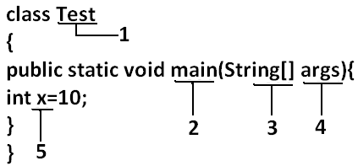
Data Types:
Identifier:
A name in java program is called identifier. It may be class name, method name, variable name and label name.
Rules to define Java identifiers:
Rule 1: The only allowed characters in java identifiers are:
a to z , A to Z , 0 to 9 , _ (underscore) , $.
Rule 2: Identifiers are not allowed to starts with digit. Example:
ABC123---------valid
123ABC---------invalid
Rule 3: If we are using any other character we will get compile time error.
total_number-------valid
Total#------------------invalid

Slide 3
Data Types:
Identifier:
Rule 4: java identifiers are case sensitive as it treated as case sensitive language.
Example:
class Test {
int number=10;
int Number=20;
int NUMBER=20; we can differentiate with case.
}
Rule 5: There is no length limit for java identifiers but it is not recommended to take more than 15 lengths.
Rule 6: We can't use reserved words as identifiers. Example: int if=10; ------invalid
Rule 7: All predefined java class names and interface names we use as identifiers.
Example -1:
class Test {
public static void main(String[] args) { int String =10; System.out.println(String);
}}
Output: 10

Slide 4
Data Types:
Identifier:
Example -2:
class Test{
public static void main(String[] args){
int Runnable=10; System.out.println(Runnable);
}}
Output: 10
Even though it is legal to use class names and interface names as identifiers but it is not a good programming practice.
Which of the following are valid java identifiers
_ab_ , int, ca$h , Total#, java2share, 123abc, Int, all@hand, Integer

Slide 5
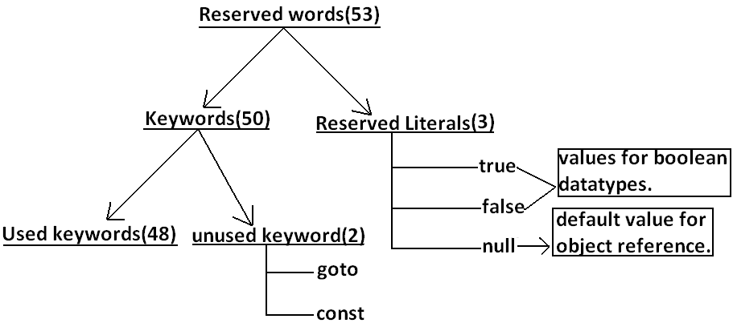
Reserved Words:
Reserved Words:
Java keywords are also known as reserved words. Keywords are particular words which acts as a key to a code. These are predefined words by Java so it cannot be used as a variable or object name.
In java some identifiers are reserved to associate some functionality or meaning.
  All reserved words in java contain only lowercase alphabet symbols.

Slide 6
Reserved Words:
Reserved Words:
Reserved words for data types: (8)
byte
short
int
long
float
double
char
boolean
Reserved words for flow control:(11)
if
else
switch
case
default
for
do
while
break
continue
return
Keywords for modifiers:(11)
public
private
protected
static
final
abstract
synchronized
native
strictfp(1.2 version)
transient
volatile
Keywords for exception handling:(6)
try
catch
finally
throw
throws
assert(1.4 version)

Slide 7
Reserved Words:
Reserved Words:
Class related keywords:(6)
class
package
import
extends
implements
interface
Object related keywords:(4)
new
instanceof
super
this
Unused keywords:(2)
goto: Create several problems in old
languages and hence it is banned in java.
const: Use final instead of this.
By mistake if we are using these keywords
in our program we will get compile time
error.
Void return type keyword:(1)
  If a method won't return anything compulsory that method should be declared with the void return type in java but it is optional in C++.
void
Reserved literals:(3)
true----values for boolean data type.
false
null ---- default value for object reference.
enum:(1)
This keyword introduced in 1.5v to define
a group of named constants

Slide 8
Reserved Words:
Which of the following list contains only java reserved words ?
final, finally, finalize (invalid) //here finalize is a method in Object class.
throw, throws, thrown(invalid) //thrown is not available in java
break, continue, return, exit(invalid) //exit is not reserved keyword
go to, constant(invalid) //here constant is not reserved keyword
byte, short, Integer, long(invalid) //here Integer is a wrapper class
extends, implements, imports(invalid) //imports keyword is not available in java
finalize, synchronized(invalid) //finalize is a method in Objectclass
instanceof, sizeOf(invalid) //sizeOf is not reserved keyword
new, delete(invalid) //delete is not a keyword
None of the above(valid)

Slide 9
Data Types:
Data types:
In Java every variable & every expression has a type . Data type is a classification that specifies which type of value a variable is going to hold.
Each & every data type is strictly defined .
Every assignment should be checked by the compiler for type compatibility. Hence , Java language is
considered as strongly typed programming language
Example:
byte = 8 bits
Range → -128 to 127.
int x =10.5;
Invalid in Java.
boolean b=0;
Valid in C language

Slide 10
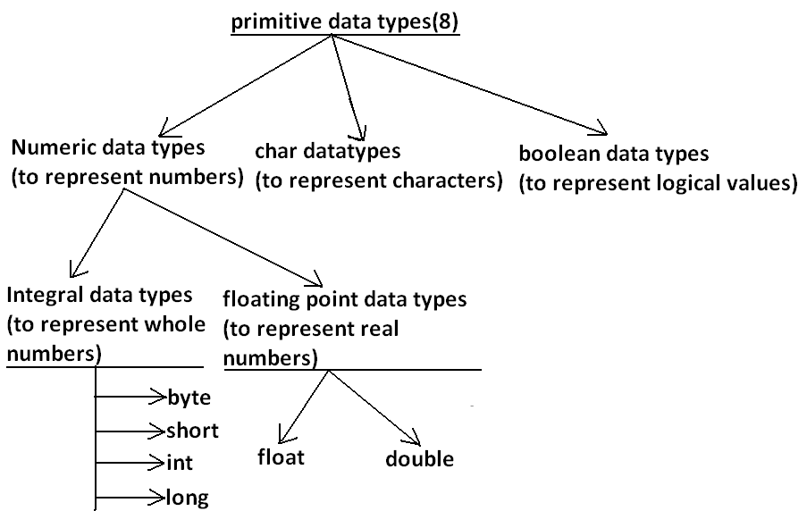
Data Types:
Except Boolean and char all remaining data types are considered as signed data types because we can represent both "+ve" and "-ve" numbers.
int x = +10; int y= -10; double d = -10.5; // valid
char c= -1; boolean b= 0; // Invalid

Slide 11
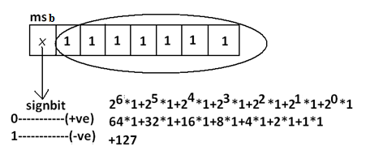
Data Types:
Data types:
Integral data types :
1. Byte:
Size: 1byte (8bits)
Max value: +127
Min value:-128
Range: -128 to 127
The most significant bit acts as the sign bit , 0 means +ve number , 1 means –ve number. Positive number will be represented directly in memory where as negative number will be in 2’s complement.
Example:
byte b=10;
byte = -127
byte b =128//C.E: possible loss of precision , found :int required :byte
byte b =10.5;//C.E: possible loss of precision
byte b=true;//C.E: Incompatible types
Where byte data type is the best choice to choose?

Slide 12
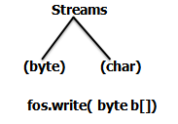
Data Types:
Data types:
Byte is the best choice if we want to handle data in terms of streams, either from file or from
network.(File supported form or network supported form.)
2. short:
The most rarely used data type in java is short.
Size: 2 bytes
Range: -32768 to 32767(-2¹⁵ to 2¹⁵-1)
Example:
short s=130;
short s=32768;//C. E:possible loss of precision
short s=true;//C .E: incompatible types
Short data type is best suitable for 16 bit processors like 8086 , but these processors are completely outdated and hence the corresponding short data type is also outdated data type

Slide 13
Data Types:
Data types:
3. int:
This is most commonly used data type in java.
Size: 4 bytes
Range:-2147483648 to 2147483647 (-2³¹ to 2³¹-1)
Example:
int i=130;
int i=10.5;//C.E: possible loss of precision
int i=true;//C.E :incompatible types
4. long:
Whenever int is not enough to hold big values then we should go for long data type.
Size: 8 bytes
Range:-2⁶³ to 2⁶³-1
Example:
To hold the no. Of characters present in a big file int may not be enough hence the return type of length() method is long. i.e. long l= f. length();//f is a file
Distance travelled by light in 1000 days , to hold this value int may not be enough, we should go for long.
Note: All the above data types (byte, short, int and long) can be used to represent integral values. If we want to represent real numbers then we should go for floating point data types.

Slide 14
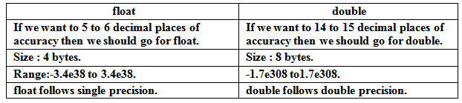
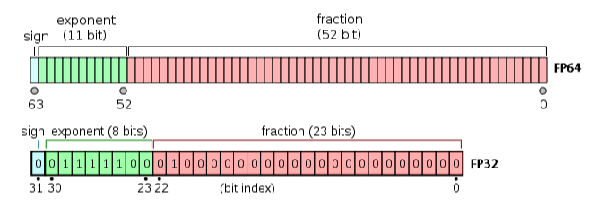
Data Types:
Data types: Floating Point Data types
5. float : If we want 5 to 6 decimal places of accuracy then we should go for float. Float follows single precision . Size of float is 4 bytes.
6. double : If we want 14 to 15 decimal places of accuracy then we should go for double. Double follows double precision . Size of double is 8 bytes.
7. boolean:
Size: Not applicable (virtual machine dependent)
Range: Not applicable but allowed values are true or false

Slide 15
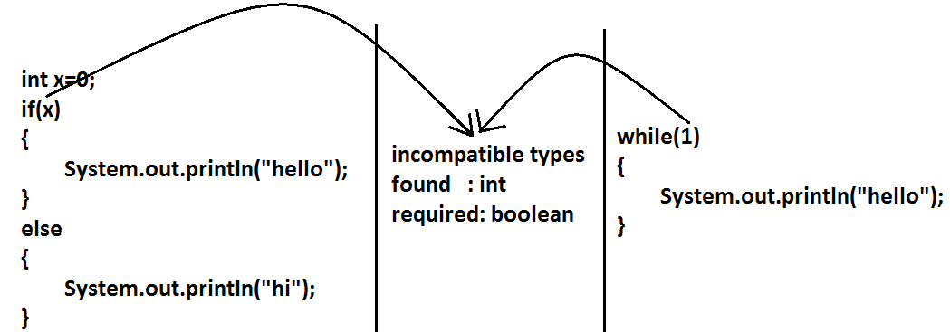
Data Types:
Data types:
Example 1:
boolean b=true; // valid
boolean b=True;//C.E: cannot find symbol
boolean b="True";//C.E: incompatible types
boolean b=0;//C.E: incompatible types
Boolean-1:
8. char:
C & C++ considers char as int having size 8 bits and range 0 to 255 and is based on ASCII code.
Java also considers char as int having size 16 bits and range 0 to 65535 and is based on Unicode
Size: 2 bytes
Range: 0 to 65535
Example:
char ch1=97;
char ch2=65536;//C.E: possible loss of precision
Char-1
Char-2
Char-3

Slide 16
Variables
Data types: (Summary):
Null is the default value of object. Null is not applicable to primitive data type.
Null is default value for object reference variable and we can not apply for primitives. If we are trying to use for primitive then we will get compile time error.
Data type | Size | Range | Corresponding Wrapper class | Default value
byte | 1 byte |  | Byte | 0
short | 2 bytes | -2¹⁵ to 2¹⁵-1 (-32768 to 32767) | Short | 0
int | 4 bytes | -2³¹ to 2³¹-1 (-2147483648 to 2147483647) | Integer | 0
long | 8 bytes | -2⁶³ to 2⁶³-1 | Long | 0
float | 4 bytes | -3.4e38 to 3.4e38 | Float | 0.0
double | 8 bytes | -1.7e308 to 1.7e308 | Double | 0.0
boolean | Not applicable | Not applicable(but allowed values true|false) | Boolean | false
char | 2 bytes | 0 to 65535 | Character | 0(represents blank space)

Slide 17
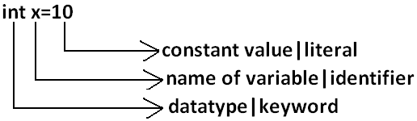
Literals :
Literals :
Any constant value which can be assigned to the variable is called literal.
Example:
Integral Literals:
For the integral data types (byte, short, int and long) we can specify literal value in the following ways.
Decimal literals: Allowed digits are 0 to 9. Example: int x=10;
Octal literals: Allowed digits are 0 to 7. Literal value should be prefixed with zero. Example: int x=010;
HexaDecimal literals:
  The allowed digits are 0 to 9, A to F.
  For the extra digits we can use both upper case and lower case characters.
  This is one of very few areas where java is not case sensitive.
  Literal value should be prefixed with ox(or) oX. Example: int x=0x10;
These are the only possible ways to specify integral literal
  Example: int x=0x10; int x=0786; int x=0777; int x=0XFace; int x=0xBase;
The programmer has the choice to specify either the value in decimal, octal or hexadecimal. But JVM will always provide the value only in decimal form.

Slide 18
Literals :
Long Literals.
By default every integral literal is int type but we can specify explicitly as long type by suffixing with small "l" (or) capital "L".
Example:
int x=10;(valid)
long l=10L;(valid)
long l=10;(valid)
int x=10l;// C.E: possible loss of precision(invalid) found : long
Byte & Short Literals.
There is no direct way to specify byte and short literals explicitly. But whenever we are assigning integral literal to the byte variables and its value within the range of byte compiler automatically treats as byte literal. Similarly short literal also.
Example:
byte b=127;(valid)
byte b=130;//C.E: possible loss of precision(invalid)
short s=32767;(valid)
short s=32768;//C.E: possible loss of precision(invalid)

Slide 19
Literals :
Floating Point Literals.
Floating point literal is by default double type but we can specify explicitly as float type by suffixing with f or F. But We can specify explicitly floating point literal as double type by suffixing with d or D.
Example:
float f=123.456;//C.E: possible loss of precision(invalid)
float f=123.456f;(valid)
double d=123.456;(valid)
double d=123.456D(valid)
float f=123.456d;(invalid)
We can specify floating point literal only in decimal form and we can't specify in octal and hexadecimal forms.
Example:
double d=123.456;(valid)
doubled=0123.456;(valid)//it is treated as decimal value but not octal
double d=0x123.456;//C.E: malformed floating point literal(invalid)
We can assign integral literal directly to the floating point data types and that integral literal can be specified in decimal , octal and Hexadecimal form also.
Example: double d=0xBeef(valid)
But we can't assign floating point literal directly to the integral types.
Example: int x=10.0;//C.E: possible loss of precision

Slide 20
Literals :
Boolean Literals.
The only allowed values for the boolean type are true (or) false where case is important. i.e., lower case
Example:
boolean b=true;(valid)
boolean b=0;//C.E: incompatible types(invalid)
boolean b=True;//C.E: cannot find symbol(invalid)
boolean b="true";//C.E:incompatible types(invalid)
Char Literals.
A char literal can be represented as single character within single quotes
Example:
  char ch='a';(valid)
  char ch=a;//C.E: cannot find symbol(invalid)
  char ch="a";//C.E:incompatible types(invalid)
  char ch='ab';//C.E: unclosed character literal(invalid)
We can specify a char literal as integral literal which represents Unicode of that character. We can specify that integral literal either in decimal or octal or hexadecimal form but allowed values range is 0 to 65535.
  Example: char ch=97;(valid)
  char ch=0xFace; (valid) System.out.println(ch);
  char ch=65536; //C.E: possible loss of precision(invalid)

Slide 21
Literals :
String Literals.
Any sequence of characters within double quotes is treated as String literal.
Example:
String s="Ashok"; (valid)
1.7 Version enhancements with respect to Literals:
    Binary Literals
    Usage of '_' in Numeric Literals
Binary Literals :
For the integral data types untill 1.6v we can specified literal value in the following ways
Decimal
Octal
Hexadecimal
But from 1.7v onwards we can specified literal value in binary form also. The allowed digits are 0 to 1.
Literal value should be prefixed with Ob or OB .
int x = 0b111; System.out.println(x)
Usage of _ symbol in numeric literals :
From 1.7v onwards we can use underscore(_) symbol in numeric literals.
double d=123456.789; //valid
double d=1_23_456.7_8_9; //valid
double d=123_456.7_8_9; //valid

Slide 22
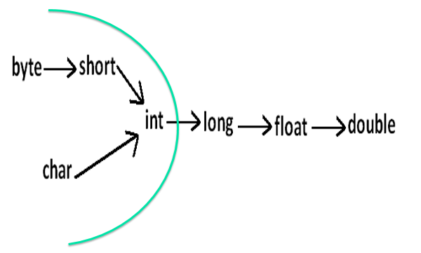
Literals :

Slide 23
Variables:
Variables:
Variable is a name given to memory location. A variable is a container which holds the value while the java program is executed. A variable is assigned with a datatype.
Types of Variables
Based on the type of value represented by a variable all variables are divided into two types:
---Primitive variables: Primitive variables can be used to represent primitive values.
int x=10;
----Reference variables: Alias name given to memory location. Reference variables can be used to
refer objects. The default value of reference is null.
Code
Based on the behaviour and position of declaration all variables are divided into the following three types:
1. Instance variables:
2. Static variables:
3. Local variables:

Slide 24
Variables :
1.Instance variables:
If the value of a variable is varied from object to object such type of variables are called instance variables. For every object a separate copy of instance variables will be created.
Instance variables should be declared with in the class directly but outside of any method or block or constructor.
Instance variables will be created at the time of object creation and destroyed at the time of object destruction hence the scope of instance variables is exactly . Instance variables will be stored in the heap as the part of object.
Instance variables can not be accessed directly from static area. But can be accessed by using object reference. We can access instance variables from instance area.
Code-1
For the instance variables it is not required to perform initialization explicitly, JVM will always provide default values. Instance variables also known as object level variables.
Code-2

Slide 25
Variables :
2.Local variables:
Some times to meet temporary requirements of the programmer we can declare variables inside a method or block or constructors, such type of variables are called local variables. Or temporary variables, stack variables or automatic variables. Local variable will be stored inside stack memory.
The local variables will be created as part of the block execution in which it is declared and destroyed once that block execution completes. The scope of local variable is the block in which we declared it.
Code-3
For the local variables JVM won't provide any default values , compulsory we should perform initialization explicitly before using that variable.
It is highly recommended to perform initialization for the local variables at the time of declaration at least with default values. Local variables are thread safe.
Note: The only applicable modifier for local variables is final. If we are using any other modifier we will get compile time error. If we not declaring with any modifier then by default it is default but this rule is applicable only for instance and static variable but not local variables.
Code-4
Void add()
{
int x;
System.out.println(“Hi”);
}
Void add()
{
int x;
System.out.println(x); // C:E
}

Slide 26
Variables :
3. Static variables:
If the value of a variable is not varied from object to object then it is not recommended to declare variable as static variable. We have to declare such type of variable at class level by using static modifier.
Example: Common Space
S1 S2 S3
In the case of instance variables for every object a separate copy will be created but in the case of static variables a single copy will be created at class level and shared by every object of the class.
Static variable should be declared within the class directly but outside of any method or block or constructor.
Static variables will be created at the time of class loading and destroyed at the time class unloading. Hence Scope of static variable is exactly same as scope of .class file.
cname
class Student
{
int rno;
String sname;
String csname;
static String cname;
}
Roll No-1
Name : KK
College: CMPICA
Roll No-2
Name : PK
College: CMPICA
Roll No-3
Name : KKPK
College: CMPICA

Slide 27
Variables :
3. Static variables:
> Java Test
1. Create and start Main Thread by JVM.
2. Locate(find) Test.class by main Thread.
3. Load Test.class by main Thread. // static variable creation
4. Execution of main() method.
5. Unload Test.class // static variable destruction
6. Terminate main Thread.
7. Shutdown JVM
Static variable will be stored in method area. We can access static variables either by object reference by class name, but recommended to use class name. Within the same class it not required to use class name we can access directly.
Code-5
We can access static variable directly from both instance and static areas.
Code-6
For the static variables , JVM will always provide default values. We are not required to perform explicitly . Static variables known as class level variable.
Code-7
Code-8

Slide 28
Variables :
Every variable in java should be either instance, static or local . Every variable in java should be either primitive or reference. Hence , various possible combinations of variable in java are primitive or reference.
Instance
Static
Local
Primitive
Reference

Slide 29
Naming Convention:
Naming Conventions: Naming conventions specify the rules to be followed by a Java programmer while writing the names of packages, classes, methods etc.
Package names are written in small letters.
e.g.: java.io, java.lang, java.awt etc.
Each word of class name and interface name starts with a capital
e.g.: Sample, AddTwoNumbers
Method names start with small letters then each word start with a capital
e.g.: sum (), sumTwoNumbers (), minValue ()
Variable names also follow the same above method rule
e.g.: sum, count, totalCount
Constants should be written using all capital letters
e.g.: PI, COUNT
Keywords are reserved words and are written in small letters.
e.g.: int, short, float, public, void

Slide 30
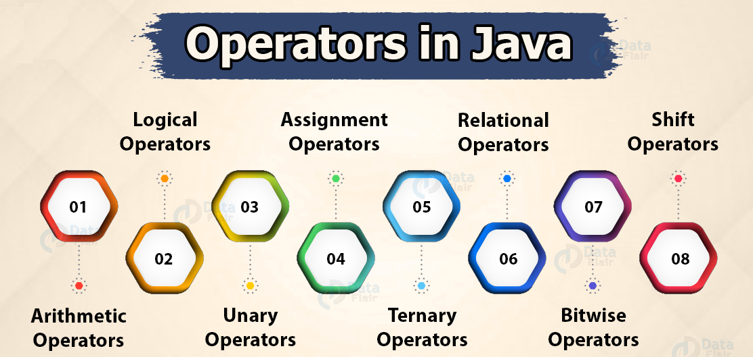
Operators:

Slide 31
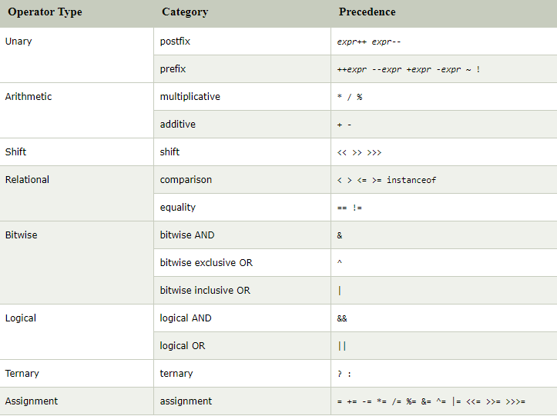
Operators:

Slide 32
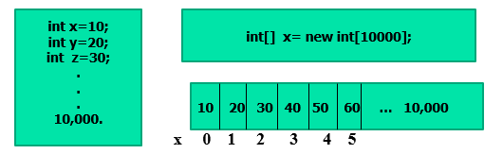
Arrays :
If statements, Switch statement, Nested switch, Loop statements, break and return
Arrays, for each loop.
Array:
An array is the indexed collection of fixed number of homogeneous data elements. An array is a collection of similar type of elements which have a contiguous memory location.
The main advantage of array is we can represent huge number of values by using single variable so that readability of the code will be improved.
The main disadvantage of arrays is fixed in size

Slide 33
Arrays :
Array Declaration:(One dimensional):
First declaration is recommended because name is clearly separated from type.
At the time of declaration we cant specify the size otherwise we will get compile time
Array Declaration:(Two dimensional):
int[] x; (Best)
int [] x;
int x[];
int[6] x; // invalid
int[] x; // valid
int[][] x;
int [][] x;
int x[][];
int[] []x;
int[] x[];
int [] x[];

Slide 34
Arrays :
Which one of the following is valid declaration?
If we want to specify the dimension before the variable that facility is applicable only for first variable in declaration. If we are trying to apply for remaining variable we will get compile time error.
int[] a, b; // a-1,b-1
int[] a[],b; // a-2,b-1
int[] a[] , b[]; // a-2,b-2
int[] [] a, b; // a-2, b-2
int[] []a, b[];//a-2, b-3
int[] [] a, []b;// invalid(C.E)
int[] []a, []b, []c; invalid(C.E)

Slide 35
Arrays :
Array Creation:
Every array in java is an object only. Hence ,we can create arrays by using new operator.
For every array type corresponding classes are available and these classes are part of java language and not available to the programmer level.
Code9:
At the time of array creation compulsory we should specify the size of array otherwise we will get compile time error.
Code10:
It is legal to have array with size 0(zero) in java.
To specify array size the allowed data types are byte, short, char and int. If we are trying to specify any
other type then we will get compile time error. Example: - Next Slide.
int[] x=new int[5];
int[] a=new int []; invalid(C.E)
int[] a =new int[5]; valid
int[] a=new int [0]; valid
int[] a=new int [-3]; RTException: NegativeArraySizeException

Slide 36
Arrays :
Array Creation:
Example :
Note : the maximum allowed size in Java is 2147483647 which is the maximum value of int data type.
Even in the first case we may get runtime exception if sufficient heap memory is not available.
int[] x=new int[5];
int[] x=new int[‘a’];
byte b=20;
int[] x=new int[b];
short s=30;
int[] x=new int[s];
int[] x=new [10l]; //C.E
int[] x=new int[2147483647]; // valid(within the range of int)
int[] x=new int[2147483648]; // C.E: Integer number too large.

Slide 37

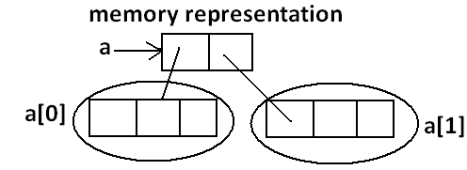
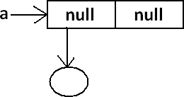
Arrays :
Array Initialization:
Whenever we are creating an array every element is initialized with default value automatically.
int[] a=new int[3];
System.out.println(a) ;//[I
System.out.println(a[0]); //0
int[][] a=new int[2][3];
System.out.println(a) ;//[[I
System.out.println(a[0]); //[I
System.out.println(a[0][0]); //10
int[][] a=new int[2][];
System.out.println(a) ;//[[I
System.out.println(a[0]); //null
System.out.println(a[0][0]); //R.E: NullP0interException

Slide 38
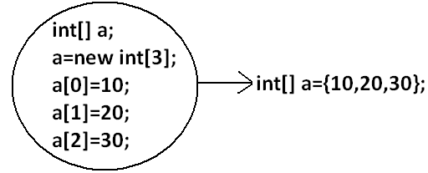
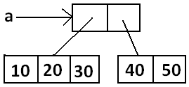
Arrays :
Array Initialization:
We can perform declaration, construction and initialization of an array in a single line.
char[] ch={'a','e', 'i', 'o', 'u'};(valid)
String[] s={“KK",“PK",“KKPK",“MP"};(valid)
Example:
int[][] a={{10,20,30},{40,50}};

Slide 39
Arrays :
Array Initialization:
length vs length():
Example-I
int[] x=new int[3];
System.out.println(x.length());//C.E: cannot find symbol
System.out.println(x.length);// 3
Code11:
Example-II
String s="bhaskar";
System.out.println(s.length);//C.E:cannot find symbol
System.out.println(s.length());//7
Code12:
length | length()
It is the final variable applicable only for arrays. | It is a final method applicable for String objects.
It represents the size of the array. | It returns the no of characters present in the String.

Slide 40
Arrays :
For each loop :
As of Java 5, the enhanced for loop was introduced. This is mainly used for Arrays.
Syntax: for each
for(declaration : expression)
{
//Statements
}
Declaration: The newly declared block variable, which is of a type compatible with the elements of the array you are accessing. The variable will be available within the for block and its value would be the same as the current array element.
Expression: This evaluates to the array you need to loop through. The expression can be an array variable or method call that returns an array.
Array-1:
Array-2:

Slide 41
Arrays :
Arrays Class in Java:
The java.util.Arrays class contains a static method that allows arrays to be viewed as List. This class contains various method for manipulating arrays (searching, sorting).The method in this class throw a NULLPointerException if the specified array reference is null.
Some other useful operations provided by methods in the java.util.Arrays class are:
Searching an array for a specific value to get the index at which it is placed (the binarySearch() method).
Comparing two arrays to determine if they are equal or not (the equals() method).
Filling an array to place a specific value at each index (the fill() method).
Sorting an array into ascending order. This can be done either sequentially, using the sort() method, or concurrently, using the parallelSort() method introduced in Java SE 8. Parallel sorting of large arrays on multiprocessor systems is faster than sequential array sorting
Array-3:
Array-4:

Slide 42
Arrays :
Enhanced Switch case with String as argument in Java (Java 7):
public class SwitchDem
{
public static void main(String[] args)
{
String game = "Card-Games";
switch(game){
case "Hockey": case"Cricket": case"Football":
System.out.println("This is a outdoor game");
break;
case "Chess": case"Card-Games": case"Puzzles": case"Indoor basketball":
System.out.println("This is a indoor game");
break;
default:
System.out.println("What game it is?");
}
}
}

Slide 43
Arrays :
Traditional Switch case in Java:
public void daysOfMonth(int month) {
switch (month) {
case 1:
case 3:
case 5:
case 7:
case 8:
case 10:
case 12:
System.out.println("this month has 31 days");
break;
case 4:
case 6:
case 9:
System.out.println("this month has 30 days");
break;
case 2:
System.out.println("February can have 28 or 29 days");
break;
default:
System.out.println("invalid month");
}
}

Slide 44
Arrays :
Enhanced Switch case in Java:: (Java 14)
switch (month) {
case 1, 3, 5, 7, 8, 10, 12 -> System.out.println("this month has 31 days");
case 4, 6, 9 -> System.out.println("this month has 30 days");
case 2 -> System.out.println("February can have 28 or 29 days");
default -> System.out.println("invalid month");
}

